Slide 1

ECE 266 Lab2 Design Review
Mingjie Ma
Chengming Li
University of California, San Diego, La Jolla, CA, USA

Slide 2
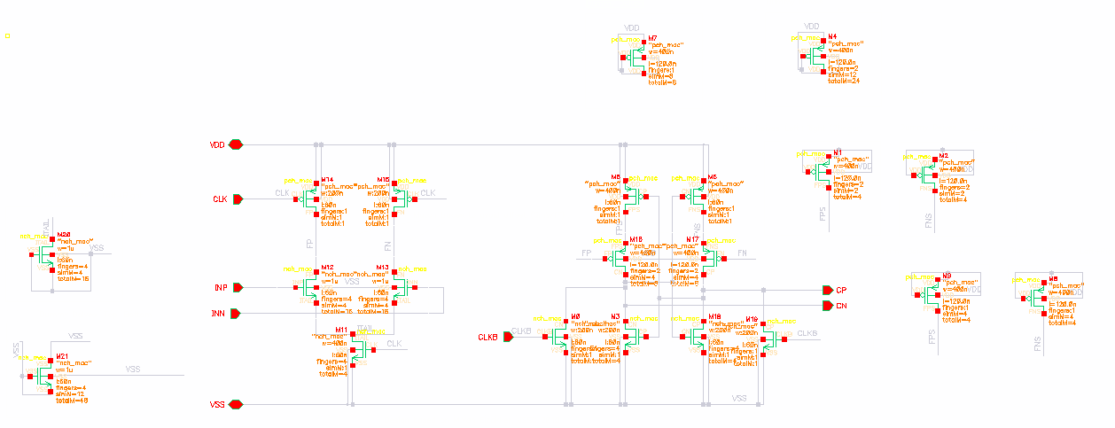
Schematic
Dummy Devices for M12 and M13:
Top+bottom(DGS are shorted to VSS): 4fin * 12m * 1u Left+Right(D-Itail, GS are shorted to VSS): 4fin * 4m *1u

Slide 3
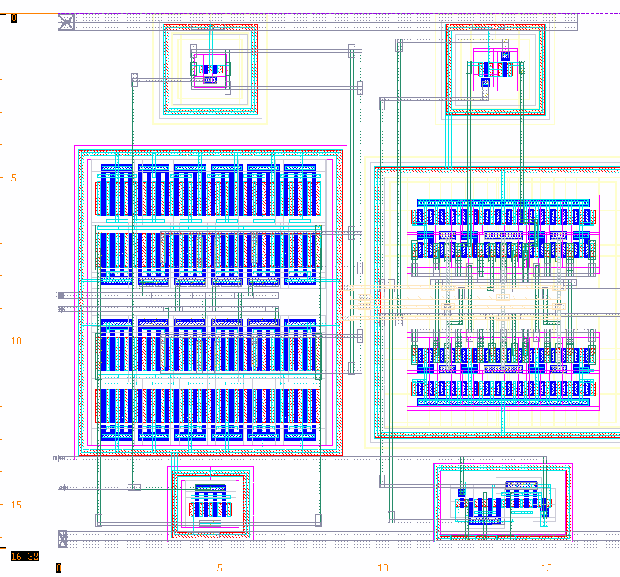
Comparator Layout
Common Centroid Pattern
ABBA
BAAB
After dummy devices
(D:2 fingers; d: 1fingers)
DDDDDD
DABBAD
DBAABD
DDDDDD

Slide 4
Schematic
Dummy Devices for M17 and M18:
Top Bottom(DGS - VDD): 1fin * 8m * 400n
2fin * 12m * 400n Left+Right(GS- VDD, D- FNS/FPS): 1fin * 8m *400n
2fin * 4m * 400n
Top + Bottom
Left + Right

Slide 5
Comparator Layout
Common Centroid Pattern
ABBA
BAAB
After dummy devices
(D:2 fingers; d: 1fingers)
DDddDDddDD
DAddBBddAD
DBddAAddBD
DDddDDddDD

Slide 6
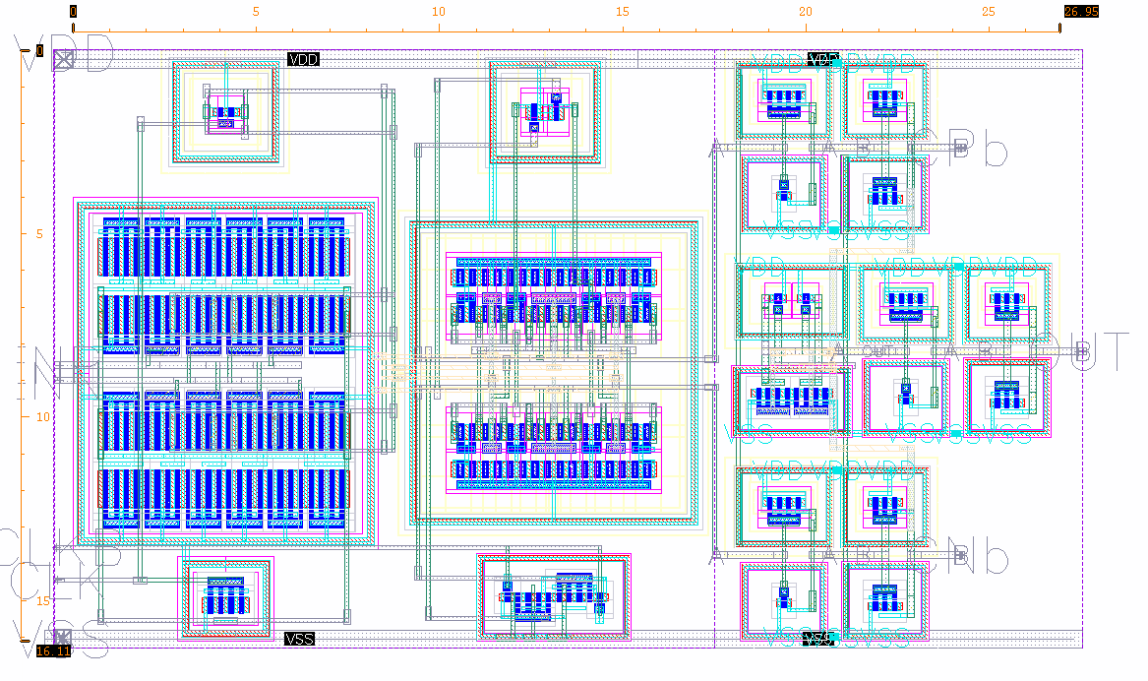
Top Level Layout
Comparator
RS_Latch
1st Stage
2nd Stage
16.11u
26.95u

Slide 7
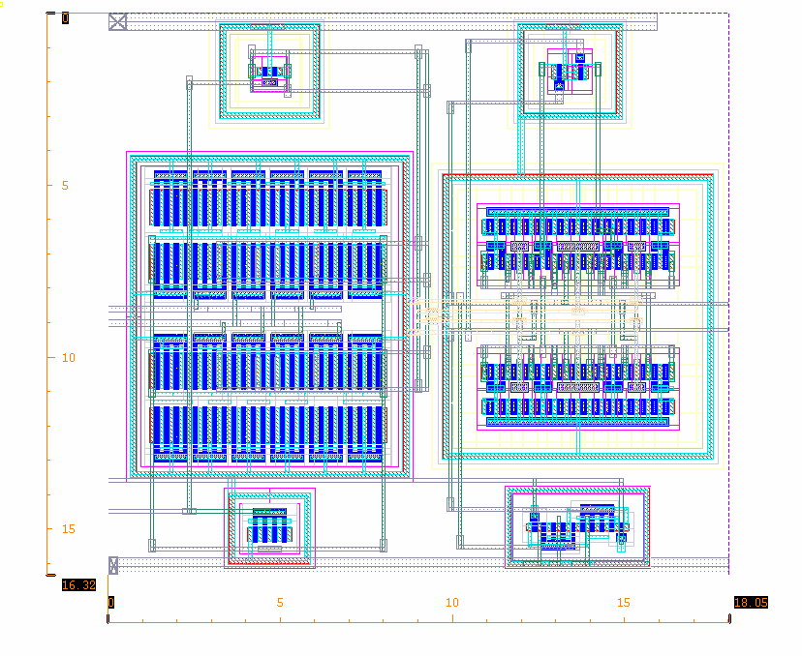
Comparator Layout
CP
INP
16.32u
INN
CLKB
CN
CLK
18.05u

Slide 8
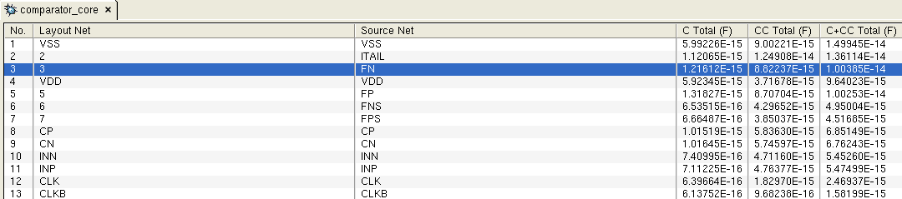
RCX Cap Table
Source Net | C+CC (F) | Difference(%)
FP | 10.0253f
FN | 10.0385f | 0.13
CP | 6.85f
CN | 6.76f | 1.31
INP | 5.475f
INN | 5.452f | 2.3

Slide 9
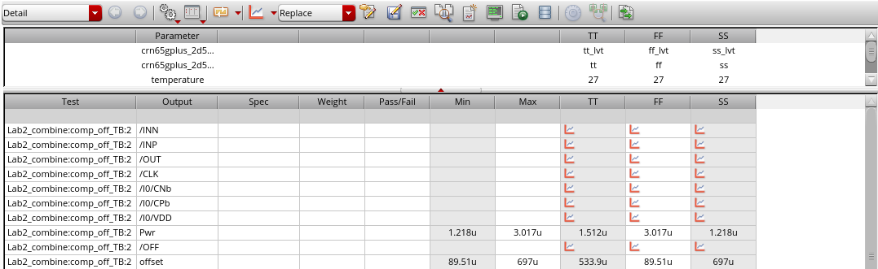
Extracted Simulation(Offset) – Process Corners
Test Corners | TT | FF | SS
#1 Iteration | 5.545m | 6.725m | 4.428m
#2 Iteration | 533.9u | 89.51u | 697u
C+CC Extraction

Slide 10
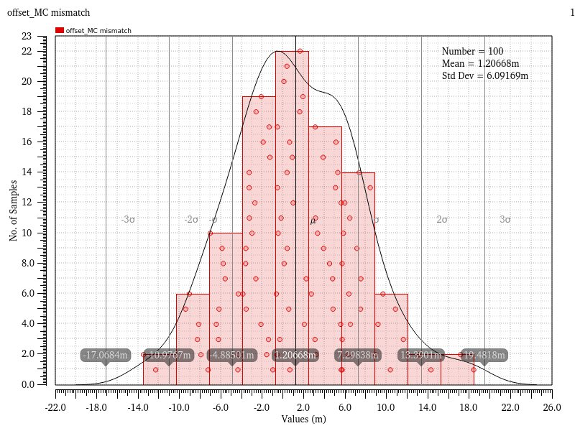
Extracted Simulation(Offset) – Mismatch
C+CC Extraction

Slide 11
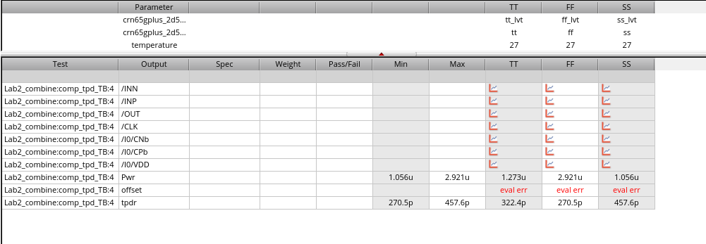
Extracted Simulation(Tpd) – Process Corners
Test Corners | TT | FF | SS
Tpd(s) | 322.4p | 270.5p | 457.6p
C+CC Extraction

Slide 12
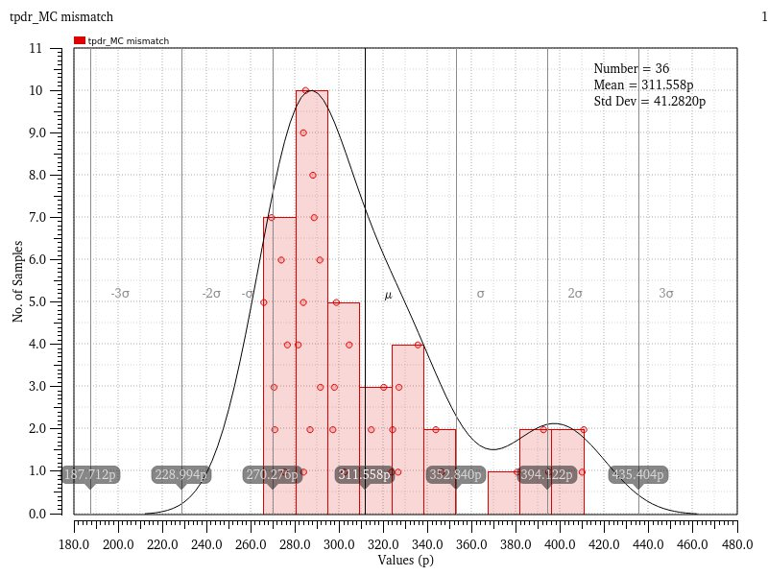
Extracted Simulation(Tpd) – Mismatch
C+CC Extraction

Slide 13
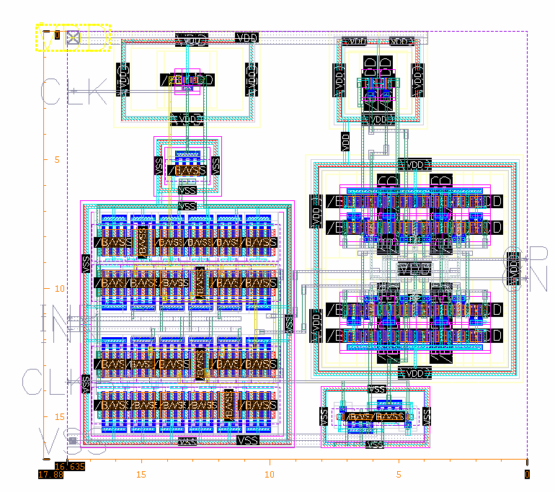
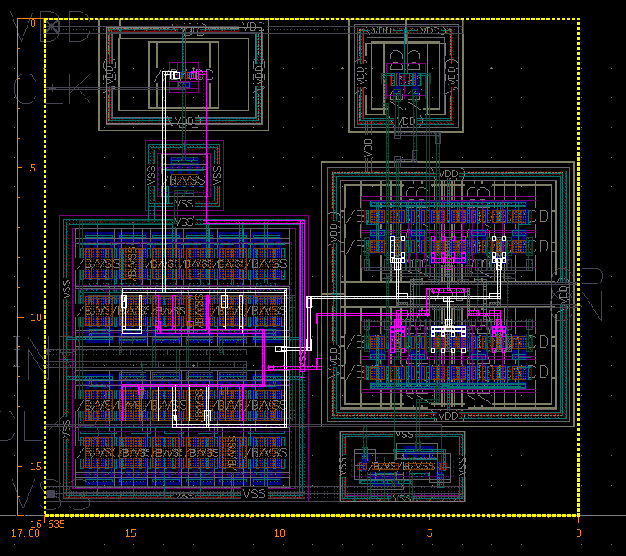
Appendix - #1 Iteration

Slide 14
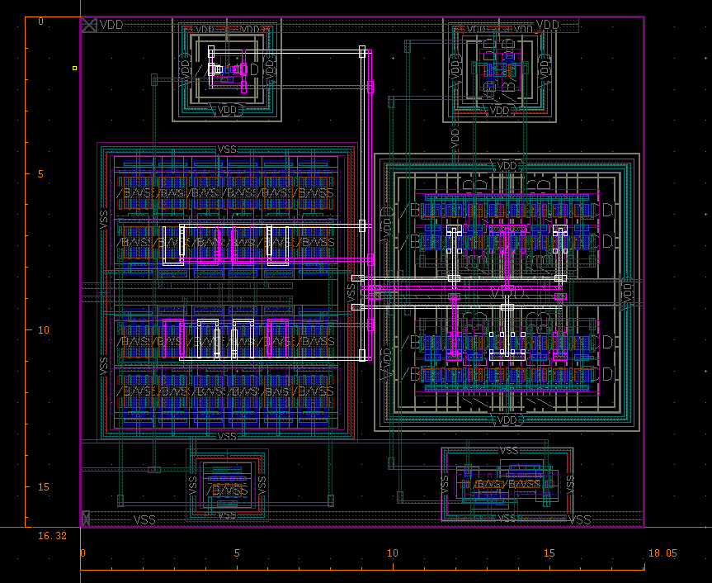
Appendix - #2 Iteration

Slide 15
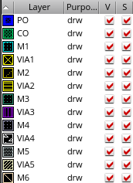
Appendix – Metal Color

